Slide 1

A Dissertation Submitted To
A MULTIVARIATE ANALYSIS OF COVARIANCE OF MEASURING STUDENT LEARNING AT A COMMUNITY COLLEGE
An Assessment of Student Learning
By: Steven D. Carver MS, MS
Date: January 20, 2021
The School of Education
OAKLAND CITY UNIVERSITY

Slide 2

HLC Accreditation April 2019
What started me on this path of research?
20 of 21 Core Components were “Met”
1 Core Component was identified as “Met with Concerns”
Assessment of Student Learning?
2 of 30

Slide 3
Preliminary Implementation Plan
Dissertation as Pilot – completed May 2021
School of IT - Indianapolis
State-wide School of IT
Indianapolis Service Area
Ivy Tech Community College
3 of 30

Slide 4
Dissertation Overview
Introduction
Review of Literature
Methodology
Results
Conclusions
and
Implications
5 Chapters
240 Pages
36 Tables
25 Figures
12 Appendices
91 References Used
4 of 30

Slide 5
INTRODUCTION: Background
How do we measure student learning?
Zlatkin-Troitschanskaia, Shavelson, & Kuhn (2015), pointed out that measurement of competencies in higher education is a complex and multidimensional task which poses great methodological challenges.
5 of 30

Slide 6
INTRODUCTION: Statement of the Problem
In a 2016 report by Dennis Bland, the Indiana Commission for Higher Education presented its third strategic plan titled Reaching Higher, Delivering Value, which stated a bold agenda focused on increasing the value of higher education for the individual and the state. This guiding document reflected commitment to a student-focused, mission-driven, and workforce-aligned system of higher education as the state continues to strive toward Indiana’s big goal that by the year 2025 at least sixty percent of Hoosiers will have an education beyond high school (Bland, 2016).
6 of 30

Slide 7
INTRODUCTION: Statement of the Problem
Get control of measuring student learning
Provide sound decision-making information
Ever increasing demand of students educated
Multiple measurements of learning
Data Collection - IvyAnalytics
Report on a per program per campus basis
Understand institutional diversity
7 of 30

Slide 8
INTRODUCTION: Research Questions
What are the relationships between 21st Century Skills Score, Course Content Materials Score and Longitudinal Exam Score, Page Views, Participations, and Submissions?
Is there any significant difference in a community college students’ learning outcomes of 21st Century Skills based on instructional delivery methods?
Is there any significant difference in a community college students’ learning outcomes of Course Content Materials based on instructional delivery methods?
Does providing preliminary feedback on assignments increase learning of 21st Century Skills based on instructional delivery methods?
Does providing preliminary feedback on assignments increase learning of Course Content Materials based on instructional delivery methods?
8 of 30

Slide 9
REVIEW OF LITERATURE: Findings
National Association of Colleges and Employers (NACE)
https://www.odu.edu/content/dam/odu/offices/cmc/docs/nace/2019-nace-job-outlook-survey.pdf
Predicting Employment through Machine Learning
https://www.naceweb.org/career-development/trends-and-predictions/predicting-employment-through-machine-learning/
Community College Survey of Student Engagement (CCSSE)
http://www.ccsse.org/aboutsurvey/aboutsurvey.cfm
Implement Self-Assessments in the courses
https://www.coursera.org/lecture/university-teaching/interview-with-prof-royce-sadler-on-understanding-standards-TD6pE
LEAP Vision for Learning in Brief
https://www.aacu.org/sites/default/files/files/publications/LEAP_Vision_Summary.pdf
Interview with Dr. Royce Sadler (audio recording)
https://www.coursera.org/lecture/university-teaching/interview-with-prof-royce-sadler-on-understanding-standards-TD6pE
In all – 91 references were used in the research
9 of 30

Slide 10
REVIEW OF LITERATURE: Findings
Student engagement is highly correlated with how institutions of higher education measure learning. (CCSSE)
Current research, as scant as it is, seems to indicate that there is no consensus that there is any one learning outcome or even a set of learning outcomes that can be used for any particular student, course, program, degree, or institution. (NACE)
10 of 30

Slide 11
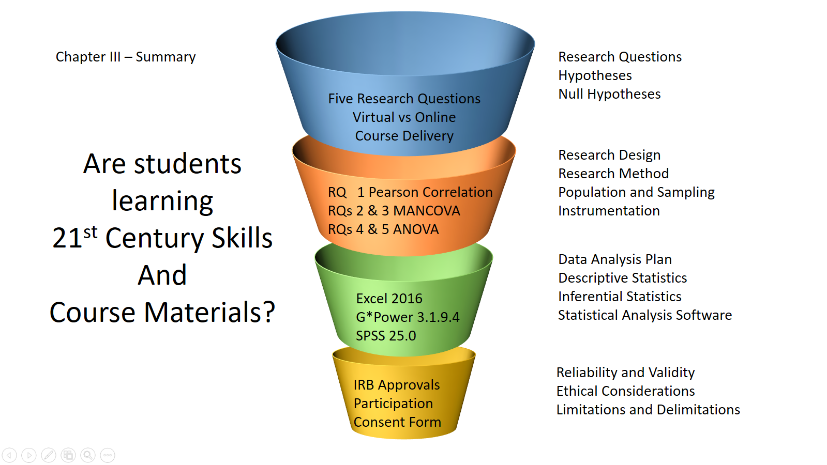
METHODOLOGY: Summary
11 of 30

Slide 12
METHODOLOGY: Research Design
School of Information Technology
Two Online and Two Virtual Sections of SDEV140
Longitudinal Course Exam (Appendix C)
Preliminary Feedback (Appendix D)
Demographic Information Survey (Appendix E)
21st Century Skills Survey (Appendix F)
Final Grade or Course Content Materials Score
Course Analytics Data from Canvas
Page Views
Participations
Assignment Submissions
12 of 30

Slide 13
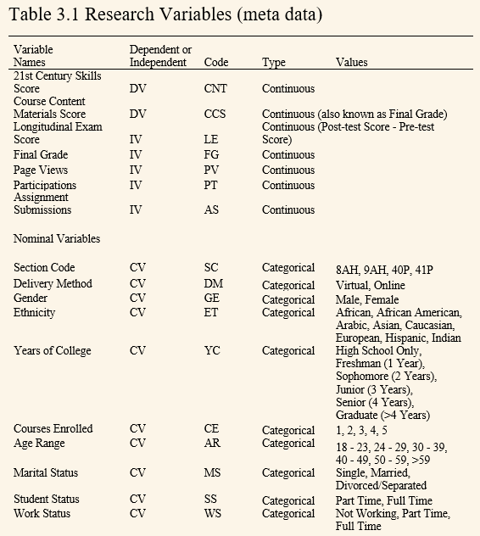
METHODOLOGY: Research Variables
13 of 30

Slide 14
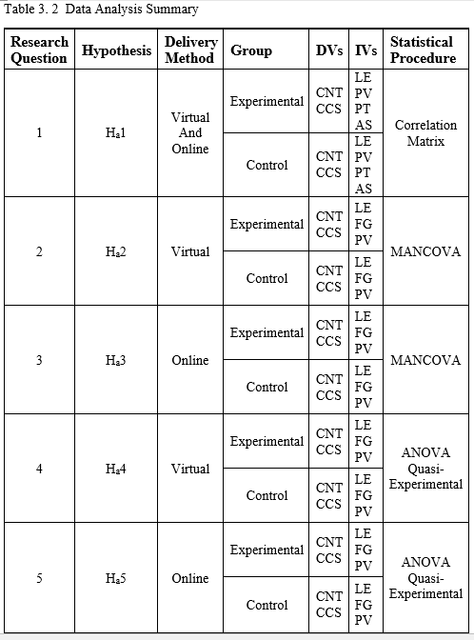
METHODOLOGY: Data Analysis
14 of 30

Slide 15
METHODOLOGY: Research Method
This study was designed to determine if there was a statistically significant difference in the amount of learning of students in relation to the two instructional delivery methods of virtual and online learners in a mid-western community college.
Three Quantitative Components
Bivariate Pearson Correlation Matrix (SPSS and Excel)
MANCOVA (SPSS)
ANOVA (SPSS and Excel)
15 of 30

Slide 16
METHODOLOGY: Population & Sampling
Population
Fall 2020 registration
School of Information Technology
approximately 1500 students at Indy campus
approximately 8000 students at state level
Convenient Sample
Hopeful to have 100 participants
Due to COVID-19 only 50 participants
16 of 30

Slide 17
METHODOLOGY: Instrumentation
Five data collection instruments used for this study
Pre- and Post-test data were collected using the Longitudinal examination The exams were distributed to all students in each section via Canvas, the college’s Learning Management System (LMS).
Composed of 100 questions made available to all registered students in each course
Demographic Information Survey using Google Form
21st Century Skills Survey using Google Form
Final Grade from Canvas Grade Center
Course Analytics Data coming from Canvas
Page Views
Participations
Assignment Submissions
17 of 30

Slide 18
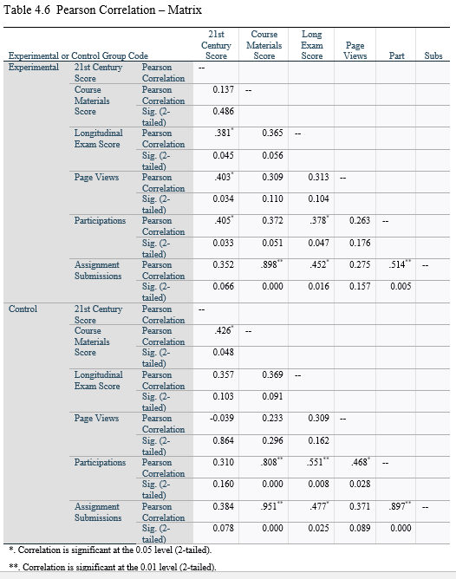
RESULTS: RQ1 Correlation Matrix
18 of 30

Slide 19
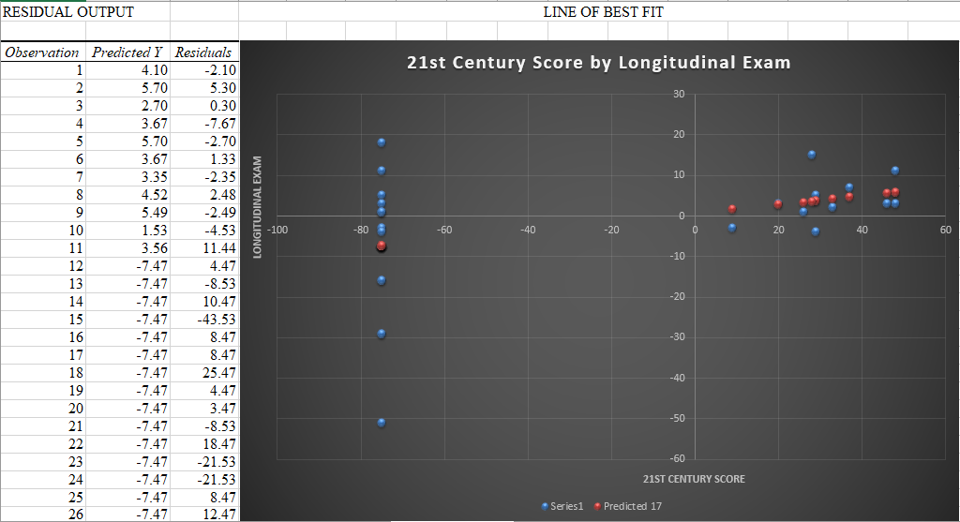
RESULTS: RQ1 Lines of Best Fit
19 of 30
Figure L.1 Line of Best Fit – 21st Century Score by Longitudinal Exam

Slide 20
RESULTS: RQ1 Conclusion
A Pearson product-moment correlation was conducted on the relationships between the dependent and independent variables using SPSS, version 25.0, 16 Pairs of Relationships being investigated.
Table 4.6 displays the results.
For example, an r coefficient of .381 (df = 1) was significant at the level p = .045, the critical value of r being .300. Because the calculated value of r = .381 (moderate) was larger than the critical value of r = .300 in Experimental group.
For example, an r coefficient of .951 (df = 1) was significant, the critical value of r being .500. Because the calculated value of r = .951 (strong) was larger than the critical value of r = .500, it was concluded that there was a significant relationship between Course Content Materials Score and Participations in Control group.
There was a significant relationship between 21st Century Score and Longitudinal Exam Scores in the Experimental group and in the Control group.
Therefore, the null hypothesis, which stated, “There are no statistically significant relationships between 21st Century Skills Score, Course Content Materials Score and Longitudinal Exam Score, Page Views, Participations, and Submissions,” was rejected.
20 of 30

Slide 21
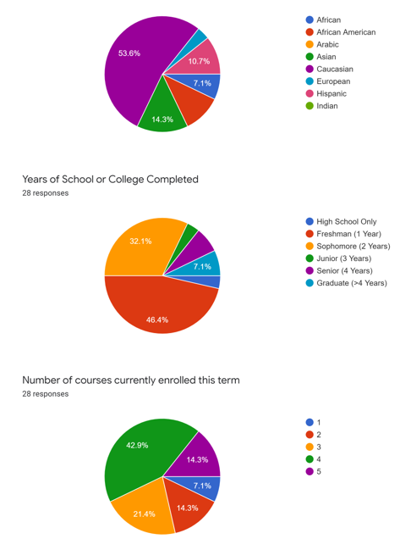
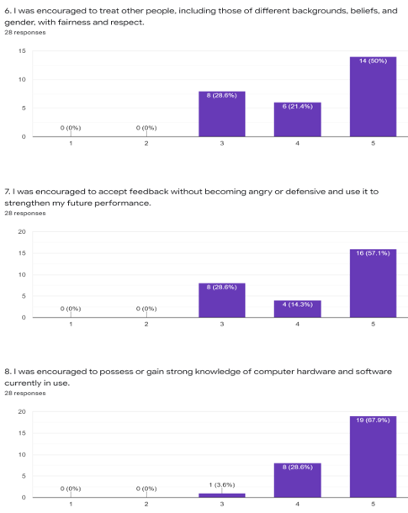
RESULTS: RQ2 and RQ3 Appendix K
21st Century Survey Descriptive Statistics
21 of 30

Slide 22
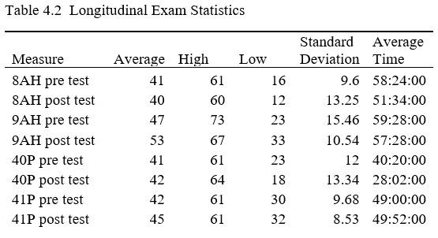
RESULTS: RQ2 and RQ3
H Sections – Virtual
P Sections – Online
22 of 30

Slide 23
RESULTS: RQ2 and RQ3 Conclusion
A two-tailed test for independent means was conducted on each of the dependent variables of 21st Century Skills and Content Materials Scores using demographic variables as covariates, using SPSS, Version 25.0.
Table 4.8 displays the results.
For example, using Pillai’s Trace from the online group with ethnicity as the covariate, an F coefficient of 1.168 (df = 2) was not significant at the level p = 0.422, the critical value of p being 0.438. Because the calculated value of p = 0.422 was smaller than the critical value of p = 0.438.
There were no significant differences between the mean scores of 21st Century Skills and Course Content Materials by online instructional delivery methods. Table 4.8 showed no significant differences.
Therefore, the null hypotheses, which stated “There is not a statistically significant difference in community college students’ learning outcomes of 21st Century Skills based on instructional delivery methods,” and “There is not a statistically significant difference in community college students’ learning outcomes of Course Content Materials based on instructional delivery methods,” were retained.
23 of 30

Slide 24
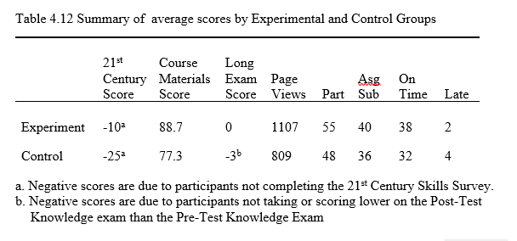
RESULTS: RQ4 and RQ5
Table 4.14 ANOVA Results
24 of 30

Slide 25
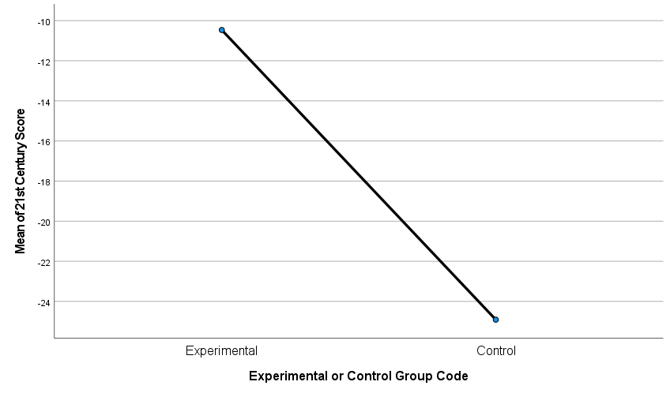
RESULTS: RQ4 and RQ5
25 of 30
Figure 4. 1 Means Plots 21st Century Score

Slide 26
RESULTS: RQ4 and RQ5 Conclusion
A one-way analysis of variance (ANOVA) was conducted using SPSS, Version 25.0 and Excel 2016’s data analysis linear regression tool which performs an ANOVA and creates a line of best fit drawn through the data points of two variables.
Levene’s test was used to assess for homogeneity of variance.
Table 4.14 shows the results of the ANOVA from SPSS, Version 25.0.
An F coefficient of 6.091 (df = 1,48) was significant at the level p = 0.017, the critical value of F being 3.95739. Because the calculated value of F = 0.840 was larger than the critical value of F = 3.95739.
There were significant differences found among 21st Century Skills and Course Content Materials score.
Therefore, the null hypotheses, which stated “There is not a statistically significant difference in learning of 21st Century Skills based on preliminary feedback being provided on assignments,” and “There is not a statistically significant difference in learning of Course Content Materials based on preliminary feedback being provided on assignments,” were retained.
26 of 30

Slide 27
Conclusions – Key Findings
There were some statistically significant relationships found between 21st Century Skills Score, Course Content Materials Score and Longitudinal Exam Score, Page Views, Participations, and Assignment Submissions.
There were not statistically significant differences in community college students’ learning outcomes of 21st Century Skills and Course Content Materials based on instructional delivery methods.
There were statistically significant differences in learning of 21st Century Skills and Course Content Materials based on preliminary feedback being provided on assignments.
27 of 30

Slide 28
IMPLICATIONS: Future Directions
Conduct this study with different college departments or schools, different courses, expand to multiple campuses.
Conduct this study at nonprofit public colleges as well as for-profit colleges should be explored.
Explore ways to vary course delivery methods to improve student success.
Replicate this study during a time when enrollments are not significantly diminished due to COVID-19.
28 of 30

Slide 29
IMPLICATIONS: Recommendations
Short Term
Better Encouragement
Better Assessment Methods
Long Term
Better Data Collection
Shift to Student-Centered Approach
29 of 30

Slide 30
Questions
Finally, we are all in this together, and ultimately, we MUST “⁹ Let love be without hypocrisy. Abhor what is evil. Cling to what is good. ¹⁰ Be kindly affectionate to one another with brotherly love, in honor giving preference to one another; ¹¹ not lagging in diligence, fervent in spirit, serving the Lord; ¹² rejoicing in hope, patient in tribulation, continuing steadfastly in prayer; ¹³ distributing to the needs of the saints, given to hospitality. ¹⁴ Bless those who persecute you; bless and do not curse. ¹⁵ Rejoice with those who rejoice, and weep with those who weep. ¹⁶ Be of the same mind toward one another. Do not set your mind on high things, but associate with the humble. Do not be wise in your own opinion. ¹⁷ Repay no one evil for evil. Have regard for good things in the sight of all men. ¹⁸ If it is possible, as much as depends on you, live (EDUCATE and WORK) peaceably with all men.” Romans 12:9-18 (NKJV).
Thank you!
30 of 30

